Slide 1
Controlled Experiments
Presenter
  Stephen Kimani
Notes:
Opening Slide

Slide 2
Controlled Experiments
Roadmap
Introduction
Participants
Variables
Hypothesis
Experimental design
Analysis of data
Example
Closing remarks
Notes:
Opening Slide

Slide 3
Controlled Experiments
Introduction
Controlled experiments are:
considered to be the most rigorous of empirical methods
capable of providing empirical evidence to support a particular claim or hypothesis
Factors that must be considered carefully in experimental design:
participants (chosen)
variables (tested and manipulated)
hypothesis (tested)
Notes:
Introduction

Slide 4
Controlled Experiments
Participants
Should match the expected users as closely as possible e.g., age, education, general computing experience, domain knowledge, etc.
Sample size of the participants should be large enough to be considered representative of the population.
Notes:
Introduction

Slide 5
Controlled Experiments
Variables
Two main types: independent variables and dependent variables.
Independent variables
Variables/characteristics/elements of the experiment that are manipulated or changed to produce different conditions e.g., interface style, number of menu items.
Each independent variable (IV) can be given a number of different values; each value is referred to as a level of the variable.
Example: An experiment to test whether users perform faster when using a colored user interface than when using a black and white (B&W) user interface. The experiment might test with a system having a colored user interface and also with a system having a B&W user interface. The IV is user interface color mode and it has two levels (colored and B&W).
It is possible to have more than one IV.
Notes:
Introduction

Slide 6
Controlled Experiments
Variables
Dependent variables
Variables/characteristics/elements that are measured in the experiment e.g., time taken to perform a task, number of errors, time to recover from errors.
Their value is dependent on the changes made to the independent variable.
The dependent variable (DV) must be measurable in some way.
The DV must be affected by the IV and, as far as possible, it must be unaffected by other factors.
Notes:
Introduction

Slide 7
Controlled Experiments
Hypothesis
A prediction of the outcome of the experiment.
Stated in terms of IV and DV; that a variation in the IV will cause an effect on the DV.
In the experiment, we would like to prove that the prediction is correct i.e. to confirm the hypothesis. This is done by disproving/rejecting the null hypothesis (A null hypothesis states that a variation in IV does not make a difference in the DV).
Notes:
Introduction

Slide 8
Controlled Experiments
Hypothesis
Example
We want to find out whether users perform faster when using a graphical user interface than when using a command-line interface.
Independent variable (IV): interaction mode (with two levels: graphical vs. command-line)
Dependent variable (DV): task completion time
Hypothesis: Users perform faster (DV) when using a graphical user interface (IV level one) than when using a command-line interface (IV level two).
Null hypothesis: There is no difference in performance (DV) when using a graphical user interface (IV level one) or when using a command-line interface (IV level two).
There are two conditions: Graphical (G) and Command-line (C).
Notes:
Introduction

Slide 9
Controlled Experiments
Experimental Design
Two main experimental methods: between-subjects and within-subjects.
Between-subjects (randomized) design
Each participant (or a unique set of participants) performs under only one condition.
Pros
No transfer of learning.
Cons
More participants required.
The design may be used if the conditions are extremely lengthy or complicated (and there is the possibility that the participants may become fatigued).
Condition G
Condition C
Jane
Eddy
John
Cathy
Dave
Irene
Lucy
Joe
Notes:
Introduction

Slide 10
Controlled Experiments
Experimental Design
Within-subjects (repeated measures)
Each participant (or set of participants) performs under each of all the conditions.
Pros
Fewer participants needed.
Cons
Transfer of learning possible.
Counterbalancing
This is a technique for minimizing the transfer of learning effects. The order of tasks is balanced out.
Condition G
Condition C
Jane
Jane
John
John
Dave
Dave
Lucy
Lucy
Notes:
Introduction

Slide 11
Controlled Experiments
Experimental Design
Within-subjects (repeated measures)
The foregoing example, now counter-balanced:
Participant
Order of Conditions
Jane
G, C
John
G, C
Dave
C, G
Lucy
C, G
Notes:
Introduction

Slide 12
Controlled Experiments
Experimental Design
Other approaches to minimize transfer of learning effects: provide some rest/break between tasks/conditions, provide some prerequisite training to the participants, etc.
Notes:
Introduction

Slide 13
Controlled Experiments
Analysis of Data
Before carrying out statistical analysis:
Look at data (could be that simple!)
Save original data (you might need to do more analysis in the future!)
The choice of statistical technique depends on factors such as:
type of data (continuous vs. discrete)
number of independent variables vs. number of dependent variables
etc
Notes:
Introduction

Slide 14
Controlled Experiments
An Example of an Experiment
Evaluating User Interface Interaction Modes
We want to find out whether users perform faster when using a graphical user interface than when using a command-line interface.
Recall
Independent variable (IV): interaction mode (with two levels: graphical vs. command-line).
Dependent variable (DV): task completion time.
Hypothesis: Users perform faster when using a graphical user interface than when using a command-line interface.
Null hypothesis: There is no difference in performance when using a graphical user interface or when using a command-line interface.
There are two conditions: graphical (G) and command-line (C).
Notes:
Introduction

Slide 15
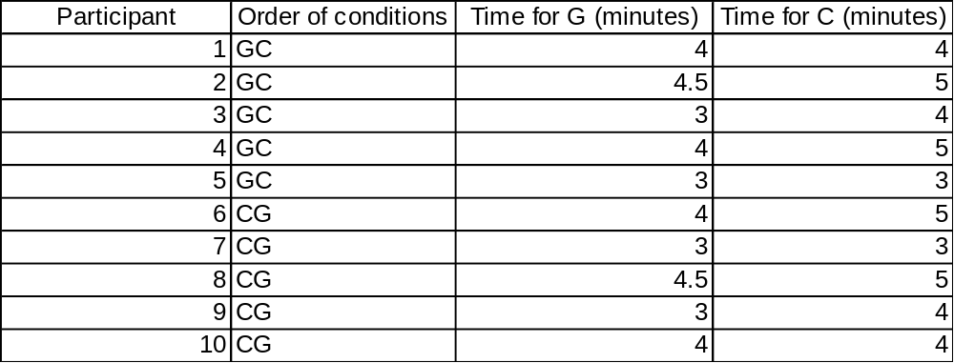
Controlled Experiments
An Example of an Experiment
Evaluating User Interface Interaction Modes
Data Collected
Notes:
Introduction

Slide 16
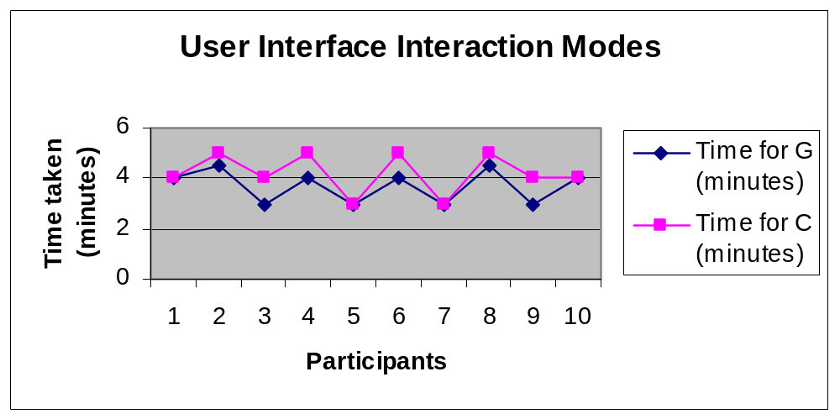
Controlled Experiments
An Example of an Experiment
Evaluating User Interface Interaction Modes
Graph
Notes:
Introduction

Slide 17
Controlled Experiments
Questions
+
Thanks
Notes:
Opening Slide

